Slide 1
Reducing the Stigma of Mental Health and Substance Use Disorders in the Workplace
Notes:
Insight and awareness on learning, growing, and compassion with reducing the Stigma of Mental Health/Addiction/ and Recovery in the Workplace.

Slide 2
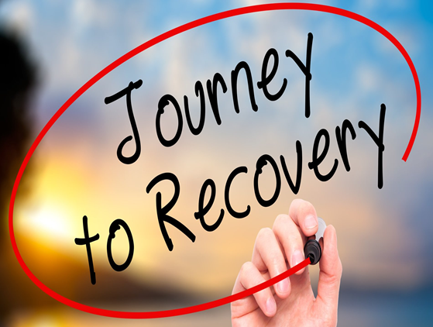
Learning objectives: ~ Create a new work environment ~ Build competencies with your staff, workplace, and organization ~ Build strategic initiatives
Notes:
Have a refreshing outlook on returning to your workplace with new information.
Share this new information.
Practice your continued journey in learning, growing and compassion.

Slide 3
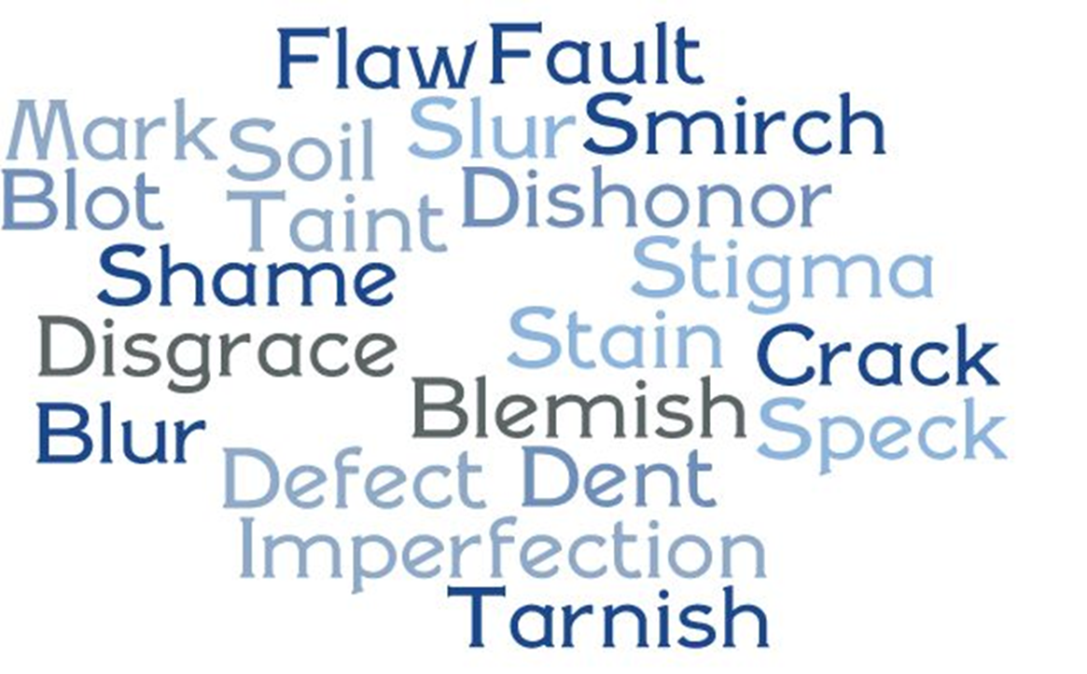
Stigma… what is a stigma?
Notes:
Merriam-Webster defines a Stigma as a set of negative and unfair beliefs that a society or group of people have about something, a mark of shame or discredit.
Reports show that those with clinical level of mental health risks DO NOT SEEK HELP, and those not seeking help report it is due to simply not wanting others to know…THIS IS STIGMA IN ACTION!
Sigma can leave people feeling ashamed, ashamed to discuss their symptoms, ashamed to seek help and this is when it becomes a BARRIER!

Slide 4
Notes:
BC2M was Founded in 2010 by award-winning actress Glenn Close, Robin Williams loss to suicide affected Glenn close and soon after she learned that her sister Jess was diagnosed with a bi-polar disorder and then Jess’s son Calen was diagnosed with Schizophrenia. So advocating for mental health has become her passion and started the Bring Change to Mind organization with the mission to end the stigma and discrimination surrounding mental health challenges.

Slide 5
Stigma Free!
Pledge to Be StigmaFree | NAMI: National Alliance on Mental Illness. (n.d.). https://www.nami.org/Get-Involved/Pledge-to-Be-StigmaFree
Notes:
National Alliance of Mental Illness – NAMI has a 3 question quiz to jump start us into taking the pledge of becoming stigma free.

Slide 6
I think people with a mental disorder…
Pledge to Be StigmaFree | NAMI: National Alliance on Mental Illness. (n.d.). https://www.nami.org/Get-Involved/Pledge-to-Be-StigmaFree
Notes:
Add in: Or how do you think people GENERALLY might view individuals with a mental disorder (*getting ppl to share more than their individual perception)

Slide 7
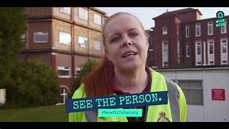
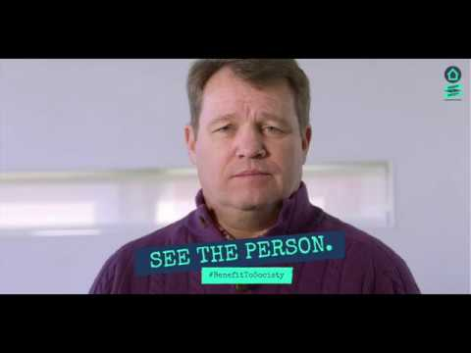
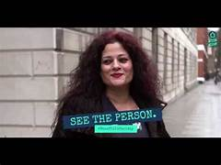
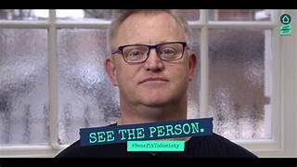
Need our love and support!
Notes:
People need our love and support. There are so many misconceptions about what a mental health challenge is and what it means to live with a mental health condition. For example, A Mental Health challenge is not the result of a personal weakness, lack of character, or a poor upbringing, likewise getting over it with will power.
Without meaning to we might send those stigmatizing messages to some struggling with a mental health condition. EVEN IF you believe that people with a mental health condition deserve to be accepted and supported, we can STILL accidentally perpetuate stigma with our language. (personal example) You can address stigma by taking a caring and understanding approach by:
Using respectful language to talk about a Mental Health challenge
Challenge misconceptions when you see or hear them
See the person, not the condition
Offer support if you think someone is having trouble

Slide 8
It’s not really a big problem, people with mental health conditions.
Notes:
True or False.

Slide 9
False: It actually is a BIG problem…
Notes:
Because It affects people’s well-being, prevents them from seeking treatment and damages self-esteem. Many people with mental health conditions don’t feel comfortable talking about what they are dealing with. Even worse, individuals with a mental challenge often internalize stigma, damaging hopes for recovery. Some don’t seek treatment, and their conditions worsen. And too often, people take their own lives because they aren’t told by anyone that they are not alone, they can recover and there is hope. Quote: with resources and support and people committed to making these changes then those problems are opportunities.

Slide 10
Susanne

Slide 11
If someone in your family is diagnosed with a mental health condition, you should:

Slide 12
Listen to them and show support…
Notes:
If someone in your family and/or a friend is diagnosed with a mental health challenge, you should listen to them and show support. Remind your love one you are there to help and you are not giving up. You can support them by:
Learning as much as possible about a mental health challenge and your family and/or friends condition.
Show interest in your family member and/or friends treatment plan.
Encourage your family member and/or friend to follow the treatment plan.
Strive for an atmosphere of cooperation within the family and workplace with a friend or co-worker.
Listen carefully.
Statements that are good to use with supporting: I’m sorry you feel bad, and I do want to help. It isn’t your fault, it’s an illness that can happen to anyone.

Slide 14
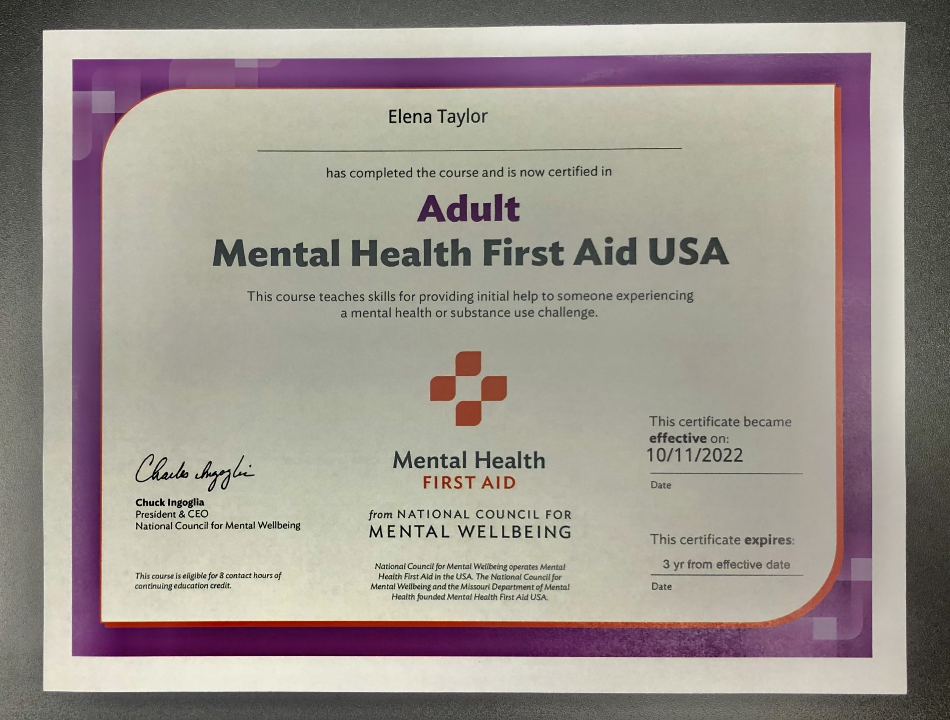
Community Services Group
Mental Health First Aid
for Adults
Book a Private Training for Your Organization
Lisa Basci
570-931-4095
basciL@csgonline.org
8-hour Training:
Certification at completion of course
csgonline.org
Resource:
320 Highland Drive Mountville, PA 17554
Community Services Group. (2024, March 4). Mental Health First Aid - Community Services Group. https://csgonline.org/mental-health-first-aid-training/
Notes:
Recent reports show that those with clinical level of mental health risks DO NOT SEEK HELP, and those not seeking help report that it is due to simply not wanting others to know…THIS IS STIGMA IN ACTION!
Stigma can leave people feeling ashamed, ashamed to discuss their symptoms, basically ashamed to seek help and this is when it becomes a BARRIER!

Slide 15
Language that feeds stigma
Instead of this…
Mental Illness
Addiction/Addict
Committed Suicide
Notes:
Person 1st. Short side note, you might encounter some people who don’t prefer the 1st person language especially those who are recovering from addiction and some people with differing abilities or disabilities. Reason for this is that someone recovering from addiction they may call themselves an addict as a reminder to them that they need to intentially chose sobriety each day. For people with a disability they might chose to say I am disabled as opposed to saying I am a person with a disability as a way to fight the stigma of having a disability. So, it is still more welcoming and/or accepting to use person 1st language as a default until told otherwise.

Slide 16
Try this. Mental Health challenge or crisis Substance use challenge or crisis Died by suicide or lost to suicide

Slide 17
Practice this:
She suffers from mental illness
She lives with a mental health challenge.
That is so crazy!
That is so surprising!
You’ll get over it eventually. Just cheer up?
I’m here to listen if you want to talk.
Why can’t you just be normal?
I admire your strength.
Notes:
Words empower like this 1st one saying she LIVES with…as opposed to she suffers from (more passive and victimizing).

Slide 18
Bring Change to Mind. (2014b, August 19). How do we change attitudes? [Video]. YouTube. https://www.youtube.com/watch?v=vjgtHLTdu5k

Slide 19
Take the Pledge with me to becoming Stigma Free! “I promise to change my behavior to support everyone affected by mental health conditions. I will listen more and judge less. I won’t use harmful words that prevent people from seeking help. I will be an ally to friends, family, and co-workers.”
Pledge to Be StigmaFree | NAMI: National Alliance on Mental Illness. (n.d.). https://www.nami.org/Get-Involved/Pledge-to-Be-StigmaFree
Notes:
In taking this pledge is shows a commitment, that you intentionally are making changes to become stigma free. Our words should mean something, one of our EDSI daily ways is Our word is our bond.

Slide 20
Being Stigma Free
Continue to educate Ourselves and others
See the Person, Not the Condition
Take Action

Slide 21
www.lyrahealth.com
Webinars that are pre-approved for 1 SHRM-CP credit and 1 HRCI credit.
Live webinar attendees will be sent an email highlighting the credit codes and resources after the event.
Lyra Health is recognized by SHRM to offer Professional Development Credits (PDCs) for SHRM-CP® or SHRM-SCP® recertification activities.
Tackling Stigma Around Workforce Mental Health
Men's Mental Health Matters: Dispelling Stigma and Bringing Awareness
Navigating Mental Well-being in the Post-pandemic Era: Insights From Our Annual Workforce Mental Health Report
Events & Webinars | Lyra Health. (n.d.). Lyra Health. https://www.lyrahealth.com/events-webinars/

Slide 22
Bryan Abrams

Slide 23
Thank you!
Best wishes on being a part of Reducing the Stigma of Mental Health and Addiction in your Work Place!

